Slide 1
African Wildlife Object Classification Project
Luis Nogales - 101512133
Isha Jayswal- 101510506
Alimul Hasan- 101474810
Braulio Cespedes- 101501661
Mohammad Abuhannood- 101437484
Pranali Karande- 101471932
Notes:
This presentation was automatically generated by PowerPoint Copilot based on content found in this document: https://insightonlinecan-my.sharepoint.com/personal/luis_nogales_insight_com/Documents/Project%20-%201%20-%20African%20Wildlife%20Object%20Classification.pdf AI-generated content may be incorrect.

Slide 2
Agenda
Introduction
Setting Up the Environment
Downloading the Dataset
Preparing the Data
Data Splitting Methodology
Loading and Preprocessing the Dataset
Data Augmentation Techniques
Building the Convolutional Neural Network
Model Summary and Parameters
Model Training and Callbacks
Training Results and Epochs
Evaluating Model Performance
Conclusion
Notes:
Agenda * Introduction * Setting Up the Environment * Downloading the Dataset * Preparing the Data * Data Splitting Methodology * Loading and Preprocessing the Dataset * Data Augmentation Techniques * Building the Convolutional Neural Network * Model Summary and Parameters * Model Training and Callbacks * Training Results and Epochs * Evaluating Model Performance * Predictions and True Labels * Model Evaluation Metrics * Conclusion

Slide 3
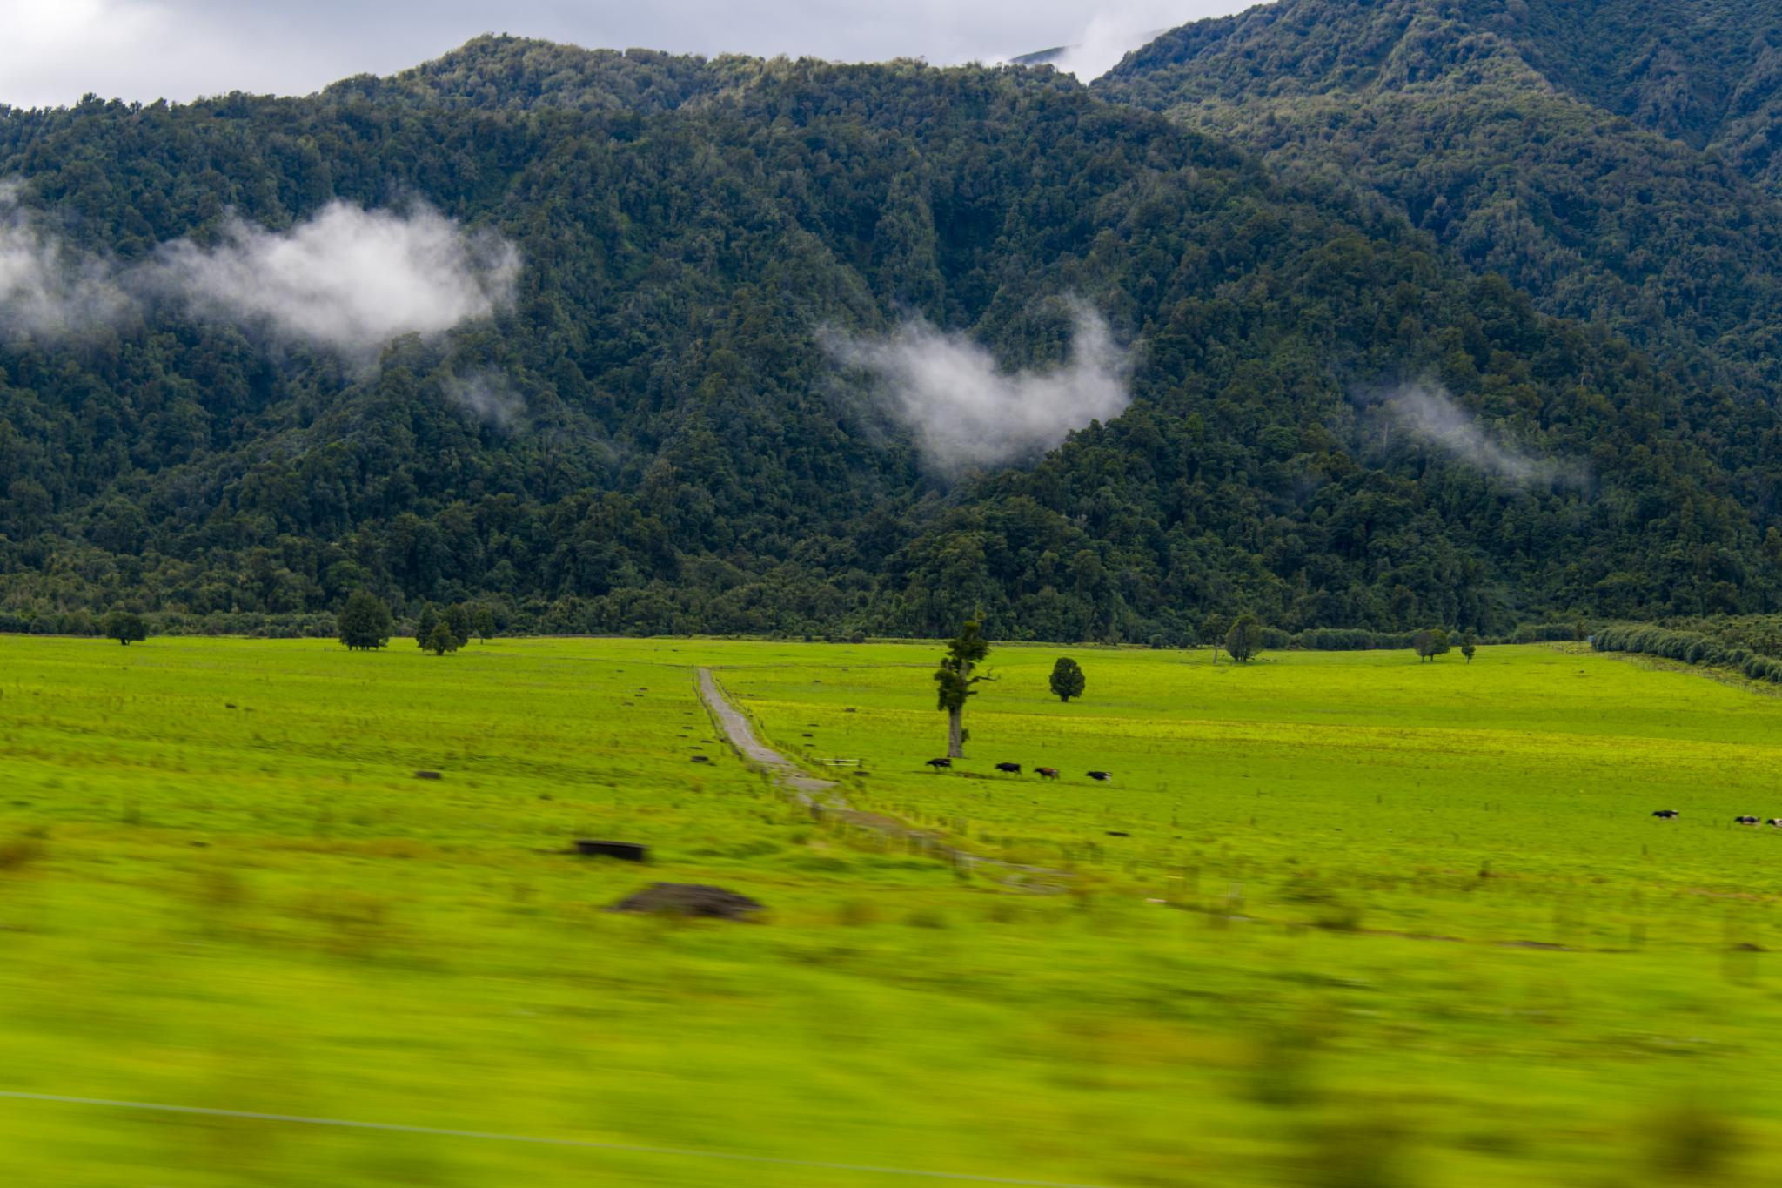
Introduction
The purpose if this project is to build a model from a pretrained model to identify wildlife in Africa. In essence, This is an object classification for the classification of 4 classes of animal in Africa, buffalos, elephants, rhinos and zebras. We explain with a lot of details the different section of our pipeline and display metrics, results and the testing evaluation of model
Notes:
Today, we'll learn how to set up Kaggle in Google Colab. First, we'll upload the necessary Kaggle configuration files. Then, we'll install the libraries required for our data project, noting that Colab already includes many essential tools. Original Content: # This section is done to upload kaggle configuration files from google.colab import files files.upload() # We install the library that we are going to use for this project # We need to clarify that a lot of the library use for displaying # and plotting data is already pre install in google colab

Slide 4
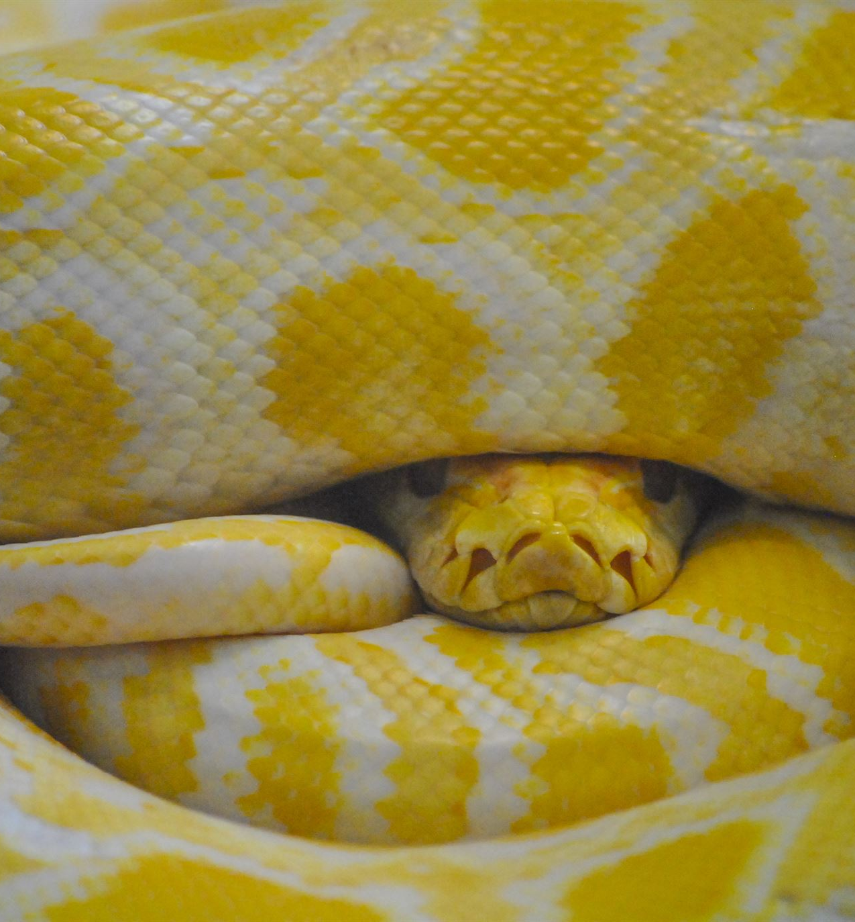
Setting Up the Environment
Installation of Kaggle and OpenCV
Use pip to install kaggle and opencv-python packages
Ensure all dependencies are satisfied
Configuration of Kaggle API
Create a directory for Kaggle configuration
Move the kaggle.json file to the new directory
Set appropriate permissions for the kaggle.json file
Notes:
Today, we'll go through the essential steps to set up Kaggle and OpenCV in Python. We'll start by installing the necessary packages using pip, followed by configuring the Kaggle API for seamless data access. Original Content: !pip install kaggle !pip install opencv-python Requirement already satisfied: kaggle in /usr/local/lib/python3.10/dist-packages (1.6 Requirement already satisfied: six>=1.10 in /usr/local/lib/python3.10/dist-packages ( Requirement already satisfied: certifi>=2023.7.22 in /usr/local/lib/python3.10/dist-p Requirement already satisfied: python-dateutil in /usr/local/lib/python3.10/dist-pack Requirement already satisfied: requests in /usr/local/lib/python3.10/dist-packages (f Requirement already satisfied: tqdm in /usr/local/lib/python3.10/dist-packages (from Requirement already satisfied: python-slugify in /usr/local/lib/python3.10/dist-packa Requirement already satisfied: urllib3 in /usr/local/lib/python3.10/dist-packages (fr Requirement already satisfied: bleach in /usr/local/lib/python3.10/dist-packages (fro Requirement already satisfied: webencodings in /usr/local/lib/python3.10/dist-package Requirement already satisfied: text-unidecode>=1.3 in /usr/local/lib/python3.10/dist- Requirement already satisfied: charset-normalizer<4,>=2 in /usr/local/lib/python3.10/ Requirement already satisfied: idna<4,>=2.5 in /usr/local/lib/python3.10/dist-package Requirement already satisfied: opencv-python in /usr/local/lib/python3.10/dist-packag Requirement already satisfied: numpy>=1.21.2 in /usr/local/lib/python3.10/dist-packag #We move our kaggle configuration file to a different directory and #give them permission so the os can access the file !mkdir -p ~/.kaggle !cp kaggle.json ~/.kaggle/ !chmod 600 ~/.kaggle/kaggle.json

Slide 5
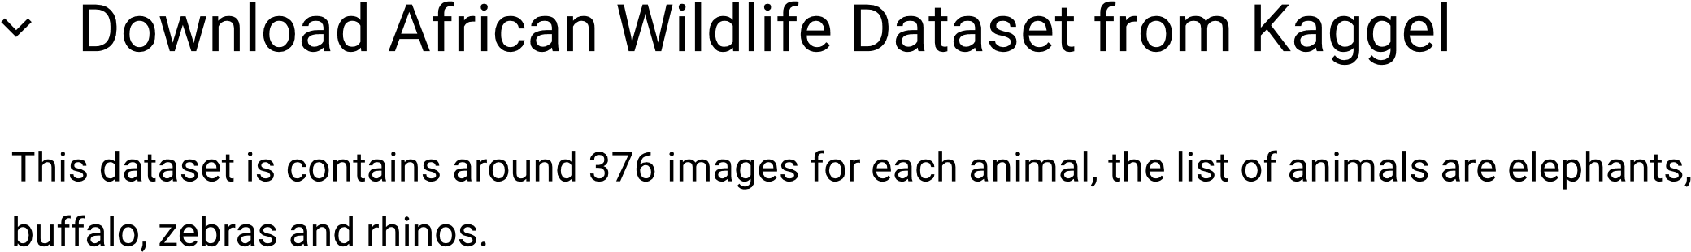
Downloading the Dataset
Dataset Information
Dataset name: African Wildlife
Source: Kaggle
Download Details
File format: ZIP
Size: Approximately 448 MB
Download time: 23 seconds
License
Status: Unknown
Notes:
We've successfully downloaded the African Wildlife dataset from Kaggle. It's a ZIP file, roughly 448 MB in size, and took about 23 seconds to download. The license status for this dataset is currently unknown. Original Content: !kaggle datasets download -d biancaferreira/african-wildlife Dataset URL: https://www.kaggle.com/datasets/biancaferreira/african-wildlife License(s): unknown Downloading african-wildlife.zip to /content 100% 447M/448M [00:23<00:00, 18.4MB/s] 100% 448M/448M [00:23<00:00, 19.8MB/s]

Slide 6
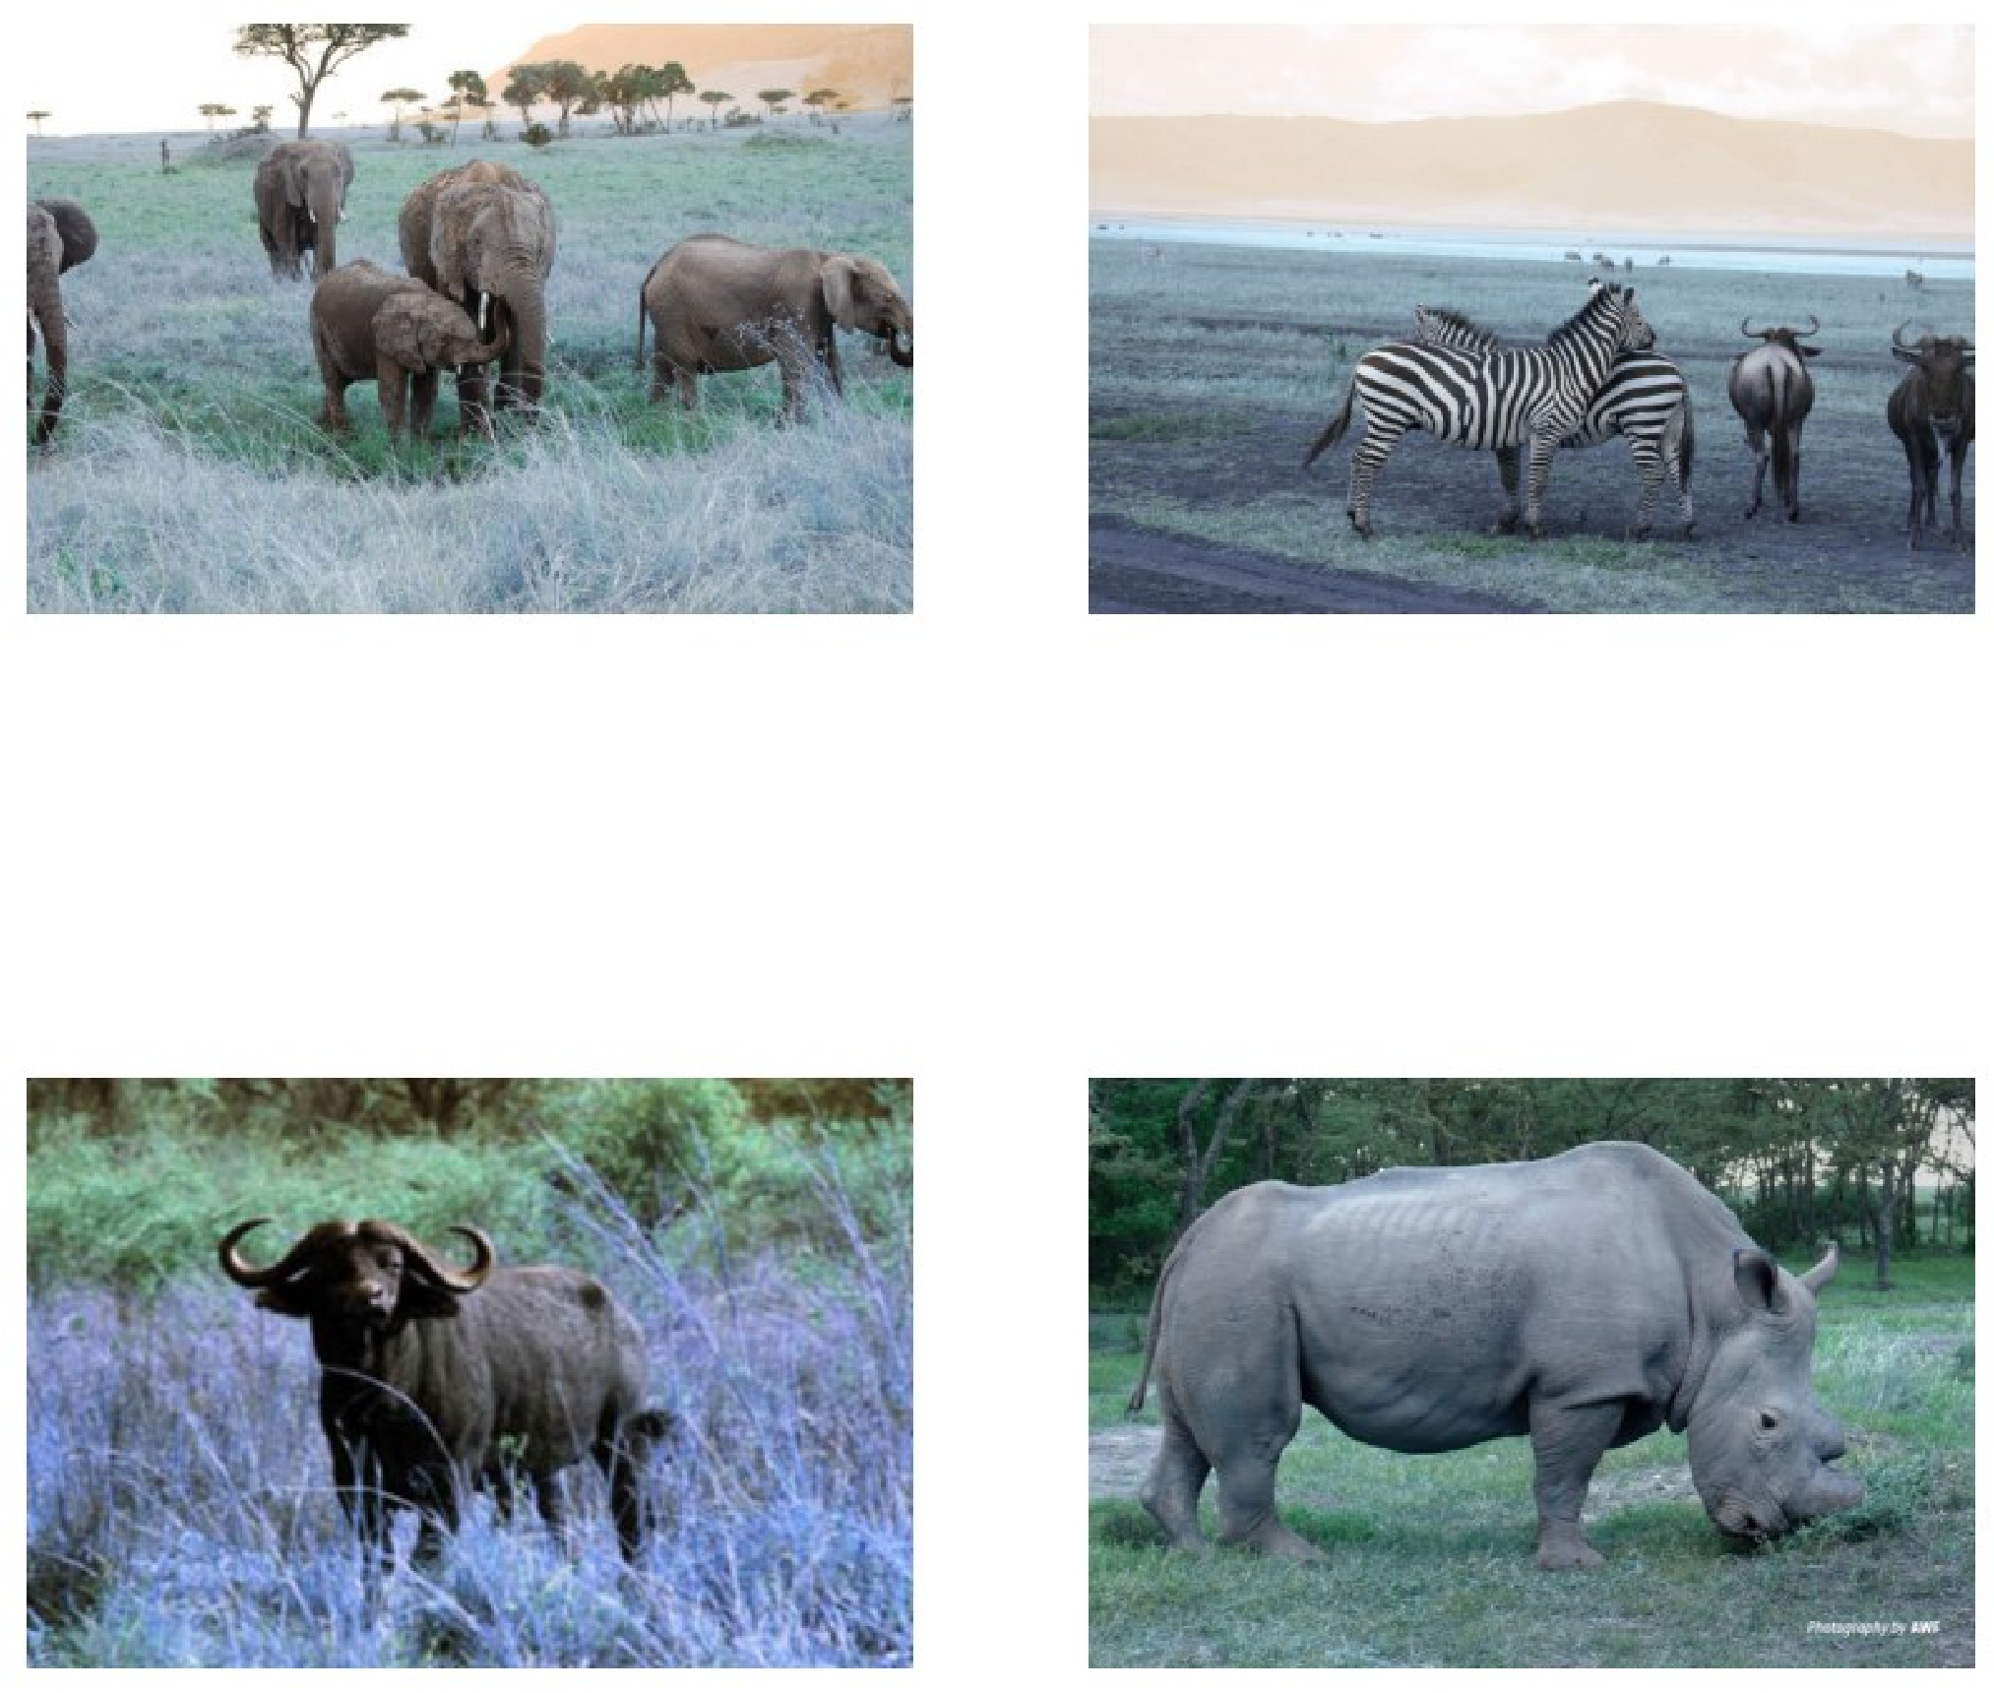
Preparing the Data
Image Data Organization
Images sorted into classes: elephants, zebras, buffaloes, rhinos
Sample images displayed using matplotlib
Data Splitting
70% training, 20% validation, 10% testing
Directories created for each data split and class
Code Implementation
Python code with os and cv2 libraries
Resizing images for model compatibility
Notes:
Today, we'll explore the process of preparing image data for a machine learning model, including organizing images into classes, splitting the data, and implementing the code. Original Content: import os import matplotlib.pyplot as plt import cv2 # From our images directory images_path = "./images" # We get a sample from each of the directories that would serve as our classes elephant_image = os.path.join(images_path, 'elephant', os.listdir(os.path.join(images_pat zebra_image = os.path.join(images_path, 'zebra', os.listdir(os.path.join(images_path, 'ze buffalo_image = os.path.join(images_path, 'buffalo', os.listdir(os.path.join(images_path, rhino_image = os.path.join(images_path, 'rhino', os.listdir(os.path.join(images_path, 'rh sample_images = [elephant_image, zebra_image, buffalo_image, rhino_image] plt.figure(figsize=(10,10)) plt.figure(figsize=( , )) for i in range(len(sample_images)): img = cv2.imread(sample_images[i]) img = cv2.resize(img, [600,400]) ax = plt.subplot(2, 2, i + 1) plt.imshow(img) plt.axis("off") plt.show() # We need to preparer the data to adjust it for our Model. # We decide to split the data into 70% for training, 20% for validation and 10% for testi #Preparing the directories for the data split base_dir = "dataset_split" #Training data directories os.makedirs(os.path.join(base_dir, 'train/buffalo'), exist_ok=True) os.makedirs(os.path.join(base_dir, 'train/elephant'), exist_ok=True) os.makedirs(os.path.join(base_dir, 'train/rhino'), exist_ok=True) os.makedirs(os.path.join(base_dir, 'train/zebra'), exist_ok=True) #Validation os.makedirs(os.path.join(base_dir, 'validation/buffalo'), exist_ok=True) os.makedirs(os.path.join(base_dir, 'validation/elephant'), exist_ok=True) os.makedirs(os.path.join(base_dir, 'validation/rhino'), exist_ok=True) os.makedirs(os.path.join(base_dir, 'validation/zebra'), exist_ok=True) #Testing os.makedirs(os.path.join(base_dir, 'test/buffalo'), exist_ok=True) os.makedirs(os.path.join(base_dir, 'test/elephant'), exist_ok=True) os.makedirs(os.path.join(base_dir, 'test/rhino'), exist_ok=True) os.makedirs(os.path.join(base_dir, 'test/zebra'), exist_ok=True)

Slide 7
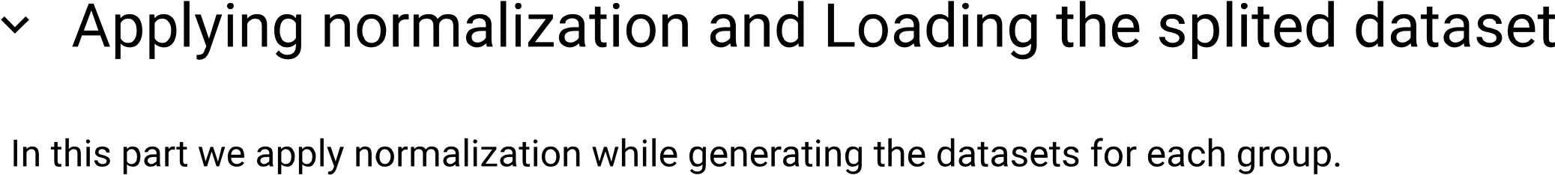
Data Splitting Methodology
Image Validation with Pillow
Verifies images using Pillow's Image.open() method
Ensures files are valid images before processing
Dataset Splitting Method
Utilizes sklearn's train_test_split function
Splits dataset into training, validation, and testing sets
Directory Organization
Creates directories for each dataset category
Copies validated images into respective folders
Dataset Classes and Directories
Defines base directory and dataset classes
Automates data preparation for machine learning
Notes:
This slide outlines the process of preparing an image dataset using the Pillow library for image validation and sklearn for data splitting. It ensures a well-organized dataset for machine learning applications. Original Content: from PIL import Image import shutil from sklearn.model_selection import train_test_split #Using Pillow (PIL) to only copy the images def is_valid_image_pillow(filename): try: with Image.open(filename) as img: img.verify() return True except (IOError, SyntaxError): return False #We create a method to split the dataset into their directories def split_data(SOURCE, TRAINING, VALIDATION, TESTING, split_size_train, split_size_val): files = [] for filename in os.listdir(SOURCE): if is_valid_image_pillow(f'{SOURCE}/{filename}'): file = os.path.join(SOURCE, filename) if os.path.isfile(file): files.append(file) #After getting the images, we split them into the percentages previously mentioned train_files, temp_files = train_test_split(files, test_size=(1 - split_size_train)) val_files test_files = train_test_split(temp_files test_size=(1 - split_size_val / (1 val_files, test_files = train_test_split(temp_files, test_size=(1 - split_size_val / (1 # Copying the files into their directories for file in train_files: shutil.copy(file, TRAINING) for file in val_files: shutil.copy(file, VALIDATION) for file in test_files: shutil.copy(file, TESTING) base_dir = './dataset_split' classes = ['buffalo', 'elephant', 'rhino', 'zebra'] for cls in classes: split_data( SOURCE=f'images/{cls}', TRAINING=f'{base_dir}/train/{cls}', VALIDATION=f'{base_dir}/validation/{cls}', TESTING=f'{base_dir}/test/{cls}', split_size_train=0.7, split_size_val=0.2 )

Slide 8
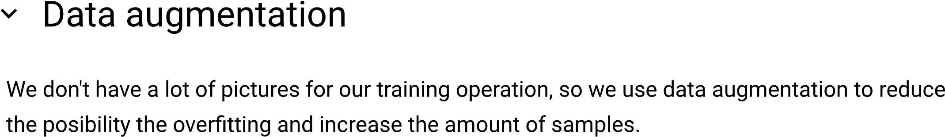
Loading and Preprocessing the Dataset
Dataset Loading Function
Loads images from directory with labels and batch size
Shuffles data for training purposes
Image Size and Batch Configuration
Set image size to 224 for consistency
Define batch size as 32 for manageable processing
Training and Validation Datasets
Train dataset contains 1276 files across 4 classes
Validation dataset has 646 files, also in 4 classes
Testing Dataset and Class Information
Test dataset comprises 393 files in 4 classes
Class names and indices confirm image categorization
Notes:
This TensorFlow code snippet demonstrates how to load an image dataset for classification tasks, with specific configurations for image size and batch processing. It ensures data is shuffled and categorized correctly for training, validation, and testing phases. Original Content: import tensorflow as tf base_dir = './dataset_split' def load_dataset(data_dir, img_size, batch_size): dataset = tf.keras.preprocessing.image_dataset_from_directory( data_dir, labels='inferred', label_mode='int', image_size=(img_size, img_size), batch_size=batch_size, shuffle=True ) return dataset img_size = 224 batch_size = 32 train_dataset = load_dataset('dataset_split/train', img_size, batch_size) val_dataset = load_dataset('dataset_split/validation' img_size batch_size) val_dataset = load_dataset('dataset_split/validation', img_size, batch_size) test_dataset = load_dataset('dataset_split/test', img_size, batch_size) Found 1276 files belonging to 4 classes. Found 646 files belonging to 4 classes. Found 393 files belonging to 4 classes. # Access class names and their indices to confirm that the images are in the correct data # This way we have an idea of what are our classes and their IDs class_names = train_dataset.class_names class_indices = {class_name: idx for idx, class_name in enumerate(class_names)} print("Class Names:", class_names) print("Class Indices:", class_indices) Class Names: ['buffalo', 'elephant', 'rhino', 'zebra'] Class Indices: {'buffalo': 0, 'elephant': 1, 'rhino': 2, 'zebra': 3}

Slide 9
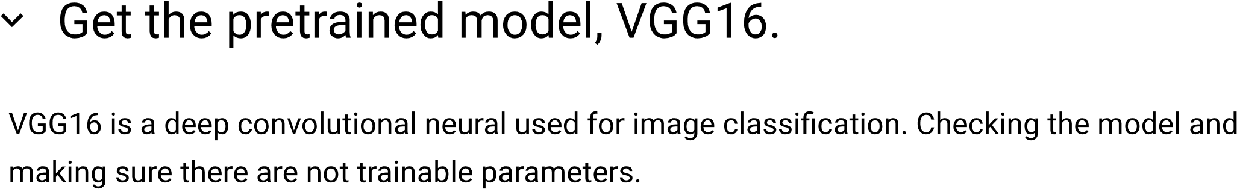
Data Augmentation Techniques
Data Augmentation Techniques
Random horizontal flipping of images
Random rotation by 20%
Random zoom by 20%
Notes:
Let's explore data augmentation, a technique to enhance our machine learning models. We'll use TensorFlow and Keras to apply random flips, rotations, and zooms to our data. Original Content: from tensorflow import keras from keras import layers data_augmentation = keras.Sequential( [ layers.RandomFlip("horizontal"), layers.RandomRotation(0.2), layers.RandomZoom(0.2) ] )

Slide 10
Building the Convolutional Neural Network
Layer (type) | Output Shape | Param #
InputLayer | (None, None, None, 3) | 0
Conv2D | (None, None, None, 64) | 1,792
MaxPooling2D | (None, None, None, 64) | 0
Conv2D | (None, None, None, 128) | 73,856
MaxPooling2D | (None, None, None, 128) | 0
... | ... | ...
Total params | 20,024,384 (76.39 MB) | 0 (0.00 Byte)
Non-trainable params | 20,024,384 (76.39 MB)
Model Acquisition and Configuration
Utilizing Keras to obtain VGG16 model
Employing ImageNet weights for the model
Model Trainability Settings
Setting 'trainable' parameter to False
Maintaining original model weights
Focusing on training only the last layers
Model Summary Overview
Insight into model's layer structure and parameters
Total, trainable, and non-trainable parameters detailed
Notes:
We're integrating the VGG16 model using Keras, with ImageNet's weights for optimal performance. The model is set to non-trainable to preserve the pre-trained weights, focusing on the last layers for training. A summary reveals the model's complex layer structure and parameter details. Original Content: # We get the model from keras and use the weights from imagenet # It's possible to use another models weight, but we are not going to explore that posibi conv_base = keras.applications.vgg16.VGG16( weights = "imagenet", include_top= False ) # We set the parameter trainable as False # We prefer to leave the weights of the model as it is, and only train the last layers th # We prefer to leave the weights of the model as it is, and only train the last layers th conv_base.trainable = False conv_base.summary() Downloading data from https://storage.googleapis.com/tensorflow/keras-applications/vg 80134624/80134624 [==============================] - 1s 0us/step Model: "vgg19" _________________________________________________________________ Layer (type) Output Shape Param # ================================================================= input_7 (InputLayer) [(None, None, None, 3)] 0 block1_conv1 (Conv2D) (None, None, None, 64) 1792 block1_conv2 (Conv2D) (None, None, None, 64) 36928 block1_pool (MaxPooling2D) (None, None, None, 64) 0 block2_conv1 (Conv2D) (None, None, None, 128) 73856 block2_conv2 (Conv2D) (None, None, None, 128) 147584 block2_pool (MaxPooling2D) (None, None, None, 128) 0 block3_conv1 (Conv2D) (None, None, None, 256) 295168 block3_conv2 (Conv2D) (None, None, None, 256) 590080 block3_conv3 (Conv2D) (None, None, None, 256) 590080 block3_conv4 (Conv2D) (None, None, None, 256) 590080 block3_pool (MaxPooling2D) (None, None, None, 256) 0 block4_conv1 (Conv2D) (None, None, None, 512) 1180160 block4_conv2 (Conv2D) (None, None, None, 512) 2359808 block4_conv3 (Conv2D) (None, None, None, 512) 2359808 block4_conv4 (Conv2D) (None, None, None, 512) 2359808 block4_pool (MaxPooling2D) (None, None, None, 512) 0 block5_conv1 (Conv2D) (None, None, None, 512) 2359808 block5_conv2 (Conv2D) (None, None, None, 512) 2359808 block5_conv3 (Conv2D) (None, None, None, 512) 2359808 block5_conv4 (Conv2D) (None, None, None, 512) 2359808 block5_pool (MaxPooling2D) (None, None, None, 512) 0 ================================================================= Total params: 20024384 (76.39 MB) Total params: 20024384 (76.39 MB) Trainable params: 0 (0.00 Byte) Non-trainable params: 20024384 (76.39 MB) _________________________________________________________________

Slide 11
Model Summary and Parameters
Neural Network Model Summary
Layer (type) | Output Shape | Param #
Input | (None, 224, 224, 3) | 0
Sequential | (None, 224, 224, 3) | 0
SlicingOpLambda | (None, 224, 224, 3) | 0
VGG16 (Functional) | (None, None, None, 512) | 14,714,688
GlobalAveragePooling2D | (None, 512) | 0
Dense | (None, 512) | 262,656
Dropout | (None, 512) | 0
Dense | (None, 4) | 2,052
Total params | Trainable params | Non-trainable params
14,979,396 (57.14 MB) | 264,708 (1.01 MB) | 14,714,688 (56.13 MB)
Notes:
This slide presents the architecture of a VGG16-based neural network model, highlighting its layers, output shapes, and parameters. The model utilizes data augmentation, dropout regularization, and a global average pooling layer to enhance performance and reduce overfitting. Original Content: from tensorflow import keras from keras import layers from tensorflow.keras.regularizers import l2 inputs = keras.Input(shape=(img_size, img_size, 3)) x = data_augmentation(inputs) x = keras.applications.vgg16.preprocess_input(x) x = conv_base(x) # GlobalAveragePooling2D help us reduce the dimension and It also help us reduce the amou # Reducing the amount of parameters is crucial at reducing potentia for overfitting and s x = layers.GlobalAveragePooling2D()(x) x = layers.Dense(512, activation = 'relu', kernel_regularizer=l2(0.001))(x) x = layers.Dropout(0.5)(x) #It would seen too harsh to dropout half of the neuron, # but in other experiment for classification problems this approach has proveed to yield outputs = layers.Dense(4, activation="softmax")(x) model = keras.Model(inputs=inputs, outputs=outputs) from tensorflow.keras.optimizers import Adam # Compile the model model.compile( optimizer=Adam(learning_rate=1e-4), loss='sparse_categorical_crossentropy', metrics=['accuracy'] ) #Final overview at the model before training model.summary() Model: "model_2" _________________________________________________________________ Layer (type) Output Shape Param # ================================================================= input_6 (InputLayer) [(None, 224, 224, 3)] 0 sequential_1 (Sequential) (None, 224, 224, 3) 0 tf.__operators__.getitem_2 (None, 224, 224, 3) 0 (SlicingOpLambda) tf.nn.bias_add_2 (TFOpLamb (None, 224, 224, 3) 0 da) da) vgg16 (Functional) (None, None, None, 512) 14714688 global_average_pooling2d_2 (None, 512) 0 (GlobalAveragePooling2D) dense_4 (Dense) (None, 512) 262656 dropout_2 (Dropout) (None, 512) 0 dense_5 (Dense) (None, 4) 2052 ================================================================= Total params: 14979396 (57.14 MB) Trainable params: 264708 (1.01 MB) Non-trainable params: 14714688 (56.13 MB) _________________________________________________________________

Slide 12
Model Training and Callbacks
Callback Functions in Model Training
Checkpoint callback saves the best model based on validation loss.
Early stopping callback monitors loss and stops training after 3 epochs with no improvement.
Model Training Process
Initial training with 10 epochs to assess learning progress.
Extended to 50 epochs for comprehensive training.
Early stopping ensures optimal model without overfitting.
Notes:
Today, we're discussing the implementation of callbacks during model training. We use a checkpoint to save the best model iteration and early stopping to prevent overfitting. Initially, we trained for 10 epochs and then extended to 50, ensuring we capture the best possible model performance. Original Content: # Defining some callbacks Checkpoint and early stopping callbacks = [ keras.callbacks.ModelCheckpoint( filepath ="./vgg16_african_wildlife_classifier5.h5", save_best_only=True, monitor="val_loss" ), keras.callbacks.EarlyStopping(monitor="loss", patience=3) ] # Checkpoint to save the best model during training # Early stopping to get the best possible model if the loss experince no changes or minor # Early stopping also helps us avoid overfitting by finalizing the training under the con # Training the model history = model.fit( train_dataset, validation_data=val_dataset, callbacks = callbacks, epochs=50 ) # We started with 10 epoch, we notice that the model was learning and It didn't appear to # So we increase the number of epoch to 50, along with the early stoping assure us to get

Slide 13
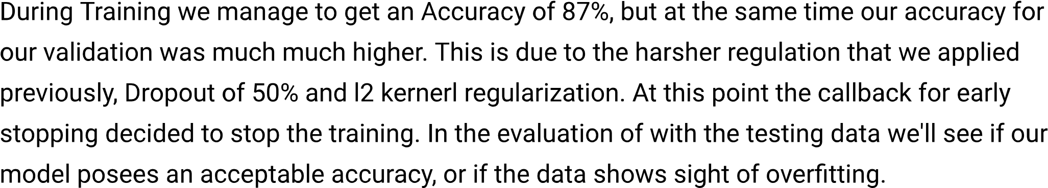
Training Results and Epochs
Notes:
We observe the machine learning model's training over 19 epochs, noting a consistent decrease in loss and a steady accuracy rate. This indicates the model's improving performance as it learns from the data. Original Content: Epoch 1/50 33/33 [==============================] - 15s 379ms/step - loss: 3.5743 - accuracy: 0. /usr/local/lib/python3.10/dist-packages/keras/src/engine/training.py:3103: UserWarnin saving_api.save_model( Epoch 2/50 33/33 [==============================] - 13s 354ms/step - loss: 2.1773 - accuracy: 0. Epoch 3/50 33/33 [==============================] - 15s 371ms/step - loss: 1.7562 - accuracy: 0. Epoch 4/50 33/33 [==============================] - 13s 331ms/step - loss: 1.5176 - accuracy: 0. Epoch 5/50 Epoch 5/50 33/33 [==============================] - 13s 331ms/step - loss: 1.3361 - accuracy: 0. Epoch 6/50 33/33 [==============================] - 13s 342ms/step - loss: 1.1361 - accuracy: 0. Epoch 7/50 33/33 [==============================] - 13s 346ms/step - loss: 1.1807 - accuracy: 0. Epoch 8/50 33/33 [==============================] - 14s 365ms/step - loss: 1.0506 - accuracy: 0. Epoch 9/50 33/33 [==============================] - 13s 340ms/step - loss: 1.1035 - accuracy: 0. Epoch 10/50 33/33 [==============================] - 13s 339ms/step - loss: 1.0378 - accuracy: 0. Epoch 11/50 33/33 [==============================] - 13s 341ms/step - loss: 1.0154 - accuracy: 0. Epoch 12/50 33/33 [==============================] - 14s 375ms/step - loss: 0.9427 - accuracy: 0. Epoch 13/50 33/33 [==============================] - 14s 357ms/step - loss: 0.9721 - accuracy: 0. Epoch 14/50 33/33 [==============================] - 13s 350ms/step - loss: 0.9456 - accuracy: 0. Epoch 15/50 33/33 [==============================] - 13s 349ms/step - loss: 0.9191 - accuracy: 0. Epoch 16/50 33/33 [==============================] - 13s 343ms/step - loss: 0.8179 - accuracy: 0. Epoch 17/50 33/33 [==============================] - 13s 350ms/step - loss: 0.8430 - accuracy: 0. Epoch 18/50 33/33 [==============================] - 13s 347ms/step - loss: 0.8467 - accuracy: 0. Epoch 19/50 33/33 [==============================] - 13s 341ms/step - loss: 0.8545 - accuracy: 0.

Slide 14
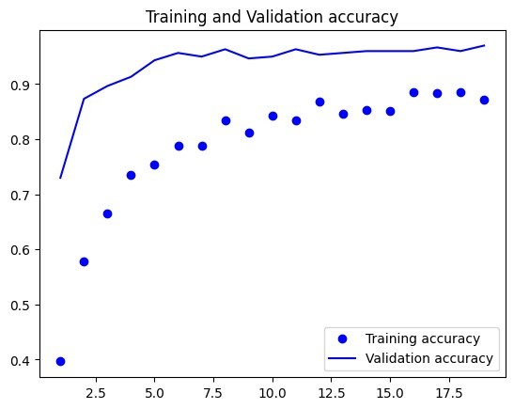
Evaluating Model Performance
Model Training Insights
Training and validation accuracy trends
Loss patterns during training
Model Evaluation
Performance on test dataset
High test accuracy achieved
Notes:
Our machine learning model shows promising results, with high accuracy in both training and validation phases. The test dataset evaluation further confirms the model's robust performance. Original Content: import matplotlib.pyplot as plt # We look into the epoch and how the training was performing with the data. accuracy = history.history["accuracy"] val_accuracy = history.history["val_accuracy"] val_accuracy = history.history["val_accuracy"] loss = history.history["loss"] val_loss = history.history["val_loss"] epochs = range(1, len(accuracy) + 1) plt.plot(epochs, accuracy, "bo", label="Training accuracy") plt.plot(epochs, val_accuracy, "b", label="Validation accuracy") plt.title("Training and Validation accuracy") plt.legend() plt.figure() plt.plot(epochs, loss, "bo", label="Training loss") plt.plot(epochs, val_loss, "b", label="Validation loss") plt.title("Training and Validation loss") plt.legend() plt.show() from tensorflow import keras #Let's try to see how the model perform with the test dataset. test_model = keras.models.load_model("/content/vgg16_african_wildlife_classifier5.h5") test_loss, test_acc = test_model.evaluate(test_dataset) print(f"Test accuracy: {test_acc: .3f}") 13/13 [==============================] - 5s 184ms/step - loss: 0.6527 - accuracy: 0.9 Test accuracy: 0.962

Slide 15
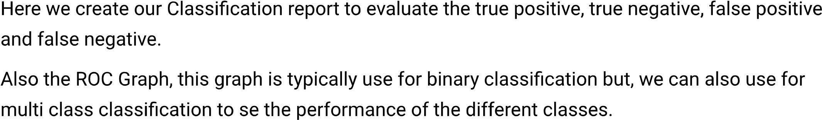
Predictions and True Labels
Acquiring True and Predicted Labels
Collect true labels from test dataset
Store model predictions and probabilities
Processing Predictions
Use 'np.argmax' for predicted labels
Convert lists to numpy arrays for analysis
Model Testing Steps
Iterate over test dataset batches
Log prediction steps and execution time
Notes:
This slide outlines the steps involved in the test phase of a machine learning model, including the acquisition of true and predicted labels, processing predictions, and logging model testing steps. Original Content: import numpy as np # Get true labels and predicted labels true_labels = [] predicted_labels = [] predicted_probabilities = [] for images, labels in test_dataset: predictions = test_model.predict(images) predicted_labels.extend(np.argmax(predictions, axis=1)) predicted_probabilities.extend(predictions) true_labels.extend(labels.numpy()) true_labels = np.array(true_labels) predicted_labels = np.array(predicted_labels) predicted_probabilities = np.array(predicted_probabilities) WARNING:tensorflow:5 out of the last 11 calls to <function Model.make_predict_functio 1/1 [==============================] - 0s 229ms/step 1/1 [==============================] - 0s 55ms/step 1/1 [==============================] - 0s 44ms/step 1/1 [==============================] - 0s 38ms/step 1/1 [==============================] - 0s 39ms/step 1/1 [==============================] - 0s 26ms/step 1/1 [==============================] - 0s 26ms/step 1/1 [==============================] - 0s 26ms/step 1/1 [==============================] - 0s 37ms/step 1/1 [==============================] - 0s 26ms/step 1/1 [==============================] - 0s 30ms/step

Slide 16
Model Evaluation Metrics
Classification Report Insights
High precision and recall for 'buffalo' and 'zebra' classes
Good performance on 'elephant' class with slight room for improvement
'Rhino' class shows lower precision, indicating potential misclassifications
Confusion Matrix Analysis
Visual representation of model accuracy
Clear distinction between predicted and true labels
ROC Curve and AUC Details
Individual class performance with AUC scores
Graphical plot to assess model's discriminative ability
Classification Report Metrics
Class | Precision | Recall | F1-Score | Support
Buffalo | 1.00 | 0.94 | 0.97 | 158
Elephant | 0.97 | 0.98 | 0.97 | 159
Rhino | 0.78 | 0.95 | 0.86 | 38
Zebra | 1.00 | 1.00 | 1.00 | 38
Notes:
Our machine learning model shows excellent precision and recall for the 'buffalo' and 'zebra' classes. The 'elephant' class is well-identified, while the 'rhino' class could benefit from further model tuning. The confusion matrix and ROC curves provide a detailed visual analysis of the model's performance. Original Content: from sklearn.metrics import classification_report, confusion_matrix, roc_curve, auc import seaborn as sns import matplotlib.pyplot as plt from sklearn.preprocessing import label_binarize # Class labels class_labels = ['buffalo', 'elephant', 'rhino', 'zebra'] # Classification Report print("Classification Report:") print(classification_report(true_labels, predicted_labels, target_names=class_labels)) # Confusion Matrix cm = confusion_matrix(true_labels, predicted_labels) plt.figure(figsize=(10, 7)) sns.heatmap(cm, annot=True, fmt='d', cmap='Blues', xticklabels=class_labels, yticklabels=c plt.xlabel('Predicted') plt.ylabel('True') plt.title('Confusion Matrix') plt.show() # ROC Curve and AUC true_labels_binarized = label_binarize(true_labels classes=[0 1 2 3]) true_labels_binarized = label_binarize(true_labels, classes=[0, 1, 2, 3]) fpr = dict() tpr = dict() roc_auc = dict() n_classes = len(class_labels) for i in range(n_classes): fpr[i], tpr[i], _ = roc_curve(true_labels_binarized[:, i], predicted_probabilities[:, roc_auc[i] = auc(fpr[i], tpr[i]) plt.figure() for i in range(n_classes): plt.plot(fpr[i], tpr[i], label=f'ROC curve of class {class_labels[i]} (area = {roc_auc plt.plot([0, 1], [0, 1], 'k--') plt.xlim([0.0, 1.0]) plt.ylim([0.0, 1.05]) plt.xlabel('False Positive Rate') plt.ylabel('True Positive Rate') plt.title('Receiver Operating Characteristic (ROC) Curve') plt.legend(loc="lower right") plt.show() Classification Report: precision recall f1-score support buffalo 1.00 0.94 0.97 158 elephant 0.97 0.98 0.97 159 rhino 0.78 0.95 0.86 38 zebra 1.00 1.00 1.00 38 accuracy 0.96 393 macro avg 0.94 0.97 0.95 393 weighted avg 0.97 0.96 0.96 393

Slide 17
Conclusion

